Slide 1
Chapter one An Overview of Computer System
Introduction to Software Engineering and Computing

Slide 2
Contents
What is Computing
Definition and characteristics of computer
Limitations of computers
Types of computers
Applications of modern computers and future computing trend
Components of Computing System
Types and Classes of Software

Slide 3
What is computing?
The activity of using computers or computer software in order to do a task
Any activity that uses computers to manage, process, and communicate information that includes development of both hardware and software.
Software Engineering is one of the major discipline of computing

Slide 4
Definition and characteristics of computer
What is Computer?

Slide 5
Computer
The word computer is derived from the word compute. Compute means to calculate. The computer was originally defined as a super fast calculator.
An electronic device that perform diverse operation with the help of predefined instruction called a program to process the information in order to archive desired results.

Slide 6
It is an electronic device, operating under the control of instructions stored in its own memory that can accept data (input) from user, process the data according to specified rules, produce information (output), and store the information for future use.
Functionalities of Computer- steps
Accepts input/data
Stores data/instructions in its memory and use them when required
Process data and convert it into useful information
Produces output

Slide 7
Characteristics of Computer
Both computers and humans can do tasks such as:
Compute numbers
Sort large number of lists
Search items from a list etc
What makes the computer special are the following basic characteristics
a. Speed
Speed of computers refers to the amount of time it takes to carryout a basic operation
In the order of micro, nano and pico seconds

Slide 8
b. Storage
Fast and efficient
Efficient because it can store large amount of information within a limited space
In a very organized manner
Fast because it can access the stored information in a fraction of a second
c. Accuracy
Unless there is an error in the input data or in the instruction used to process data computers perform tasks with a highest possible accuracy
Consistent accuracy
GIGO

Slide 9
d. Automatic
Once necessary data and instruction is feed to the computer, it can perform the task without human intervention
e. Diligence
Computers do not get tired, get bored, loss concentration
Can work for hours, or days …
Makes them suitable for routine type of work
f. Versatility
Capacity to perform completely different type of work.
As an accountant, secretary …

Slide 10
Limitations of Computer
1. No IQ
Cannot think, Need to be instructed by users
Cannot take its own decision
2. Not self directing
Computers are not self-directing & independent machines.
Precise instructions are needed even for the simplest action. However, once put in operation they hardly ever fail

Slide 11
3. No Feeling/Sympathy
Does not distinguish between what is wrong and what is right
4. No Accountability
Do not take responsibility to what they do
5. No working through trial and error
Do not learn by experience
6. No Interpretation
Do not know the interpretations of actions they take
Do what they are fed to do
1 and one are different for computers

Slide 12
In general terms computers can use for the following purposes:-
To make the work easy.
To do the work efficiently (Efficiency).
To improve the quality of the result of work (Quality).
To assist the work (Assistance).
To finish the task faster (Speed).

Slide 13
Types of Computer
There are different types of computers. The classification depends on different characteristics of computers such as:
Purpose or Functionality
Type of data handled
Physical size, price, capacity, performance and processing power of computers.

Slide 14
According to Purpose of Function
Specific Purpose
Designed to perform a single specific task.
They have set of instructions permanently programmed (pre-programmed instructions) into them that are designed to perform only one major function.
Often used as training simulator.
Examples: The public telephone box, Traffic control system, Ticket machines (used in grocery, super market etc.), ATM, Washing Machine etc...

Slide 15
2. General Purpose Computers
Designed to handle variety of tasks.
Programmed to do many different kinds of tasks, rather than one that is limited by design to a specific task.
More flexible, versatile and store large amount of data
Can have software installed for many different uses.
Example: Desktop computer, Laptop Computer, Smart phones

Slide 16
According to Type of Data Handled
Analog Computers
Recognize data as a continuous measurement of physical quantity.
Don’t compute directly with numbers, rather they use physical quantity such as electric current, voltage, mechanical motion and distance to represent and Process data.
Most of them are special purpose computers
Examples: Thermometer, voltmeter, speedometer of a car, and Gasoline pomp.

Slide 17
2. Digital Computers
handle information that can be counted. Uses digital circuits and are designed to operate on two states, namely bits ( 0 or1).
These bits can be combined to denote information such as numbers, letters, graphics, images and program instructions.
are suitable for complex computation and have higher processing speeds. They are programmable.
are the most widely used, and have higher accuracy and speed than analog computers
Examples: The general purpose computers like Desktop, smart phones etc…

Slide 18
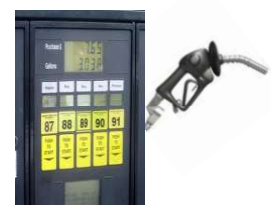
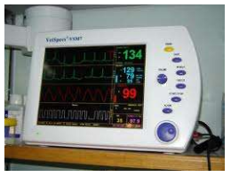
3. Hybrid Computers
is a combination of both analog and digital computer. Can handle both analog and digital data.
combines the best characteristics of both the analog and digital computer. It can accept data in both analog and digital form
Applicable in areas such as manufacturing, transportation, power systems, healthcare and others.
Example: Petrol pomp ICU device in hospitals

Slide 19
ACCORDING TO SIZE & PROCESSING POWERS
MICROCOMPUTERS ( Personal Computers)
They are relatively small or compact in size and are often found on a tabletop or desktop
come in a variety of sizes and shapes for a variety of purposes. Basically they can be grouped into three namely: Laptop, Palmtop and Desktop computers.
Laptop computers are smaller versions of microcomputers about the size of a briefcase designed for portability.
Unlike desktop PCs that have mostly detachable components, laptops include all their components (except their printer) in a single unit.

Slide 20
Cont’d
Palmtop computer is the smallest microcomputer that is about the same size as a pocket calculator.
Palmtops are typically used for a limited number of functions, such as maintaining personal calendar, name and address files, or electronic worksheets.
Desktop computer is the most widely used type of personal computer (microcomputers).
Unlike laptop and personal computers, desktop computers have detachable parts. However, since its size is larger than the other types of personal computers, it is not easily portable.

Slide 21
2. Minicomputers
Are midrange computers that are larger and more powerful than most microcomputers but are smaller and less powerful than mainframe computer systems.
The size prevents it from being easily portable although it can be moved more easily than a mainframe computer.
Most minicomputers can function in ordinary operating environments, as they do not need special air conditioning or electrical wiring.
Are being used for a large number of business and scientific applications.
They are popularly used in scientific laboratories, research centers, universities and colleges, engineering firms, industrial process monitoring and control etc.

Slide 22
3. Mainframe Computers
are large, powerful computers that are physically larger than micros and minis and usually have processors with faster instruction processing speeds.
able to process from 10 to 200 million instructions per second.
generally found in a special computer room where environmental factors such as temperature, humidity, dust and air conditions are closely monitored.
Because of the computer’s cost and the value of the information stored there, the rooms in which mainframes are located have security systems allowing only authorized personnel to enter.

Slide 23
Cont’d
have the capacities to host multiple operating systems and can handle hundreds of users (can serve up to 50,000 users simultaneously)
Designed to handle the information processing need of organization with many employees and customers or with complex computational problems.
To give some example, mainframes can handle the processing of thousands of customer inquiries, employee paychecks, student registrations, sale transactions, and inventory changes.
They are also used as the center of computer networking. These computers are used by organizations that have enormous and complex data processing assignments.

Slide 24
4. SUPERCOMPUTERS
the fastest and most expensive type of computers
Operates 4 to 10 times faster than mainframe computers
can take inputs from over 10,000 individual computers and users at the same time.
highly trained data processing professionals are required to operate supercomputers.
largely used by highly calculation-intensive tasks and research organizations, military defense systems, national weather forecasting agencies, large corporations, aircraft manufacturer etc …

Slide 25
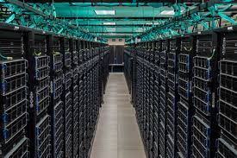
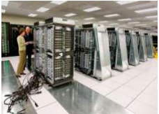
Cont’d
Some supercomputers require extra floor support to hold the extreme weight of the complete system that includes storage units.

Slide 26
Applications of Modern Computers
Now a days every field or discipline either directly or indirectly uses computer in order to process information. Here are some of the application areas of computer:
Science and Engineering
Education
Medicine and health care
Entertainment
Communication
Business application
Publishing
Banking etc…

Slide 27
Assignment 1
Write and briefly discuss the evolutions of Computers.
What are the different computer generations.
Briefly discuss the technology and programming language used in each generation.
Compare and contrast each computer generation.

Slide 28
Components of Computing System

Slide 29
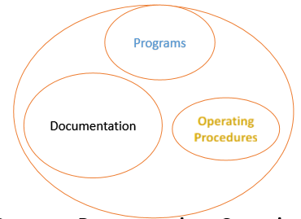
Software Vs. program
Components of software
Software= Program+ Documentation+ Operating Procedures
Software is more than programs.
It consists of programs; documentation of any facet of the program and the procedures used to setup and operate the software system.
Any program is a subset of software and it becomes software only if documentation and operating procedure manuals are prepared.
Program is a combination of source code and object code.
Documentation consists of different types of manuals.

Slide 30
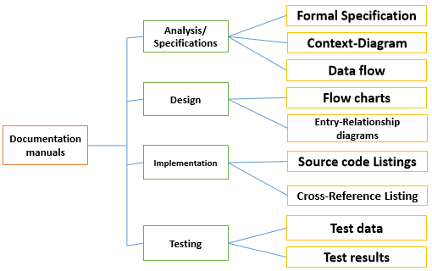

Slide 31
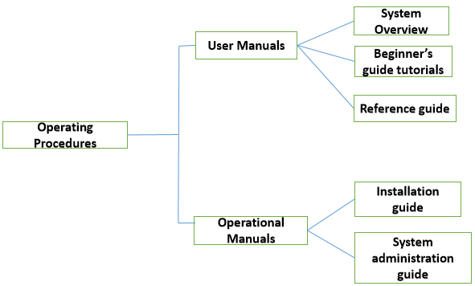
Operation procedures consist of instructions to setup and use the software system and instructions on how to react to system failure.

Slide 32
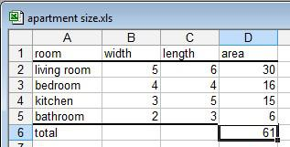
Software Applications
is a type of computer software that is designed to be employed by end users to accomplish specific tasks ; writing ,editing….
It can be also the implementation of that program.
Eg. An application software program for making spreadsheets.

Slide 33
Application Software Type | Examples
Word processing software | MS Word, WordPad and Notepad
Database software | Oracle, MS Access etc.
Spreadsheet software | Apple Numbers, Microsoft Excel
Multimedia software | Real Player, Media Player
Presentation Software | Microsoft PowerPoint, Keynotes
Enterprise Software | Customer relationship management system
Information Worker Software | Documentation tools, resource management tools
Educational Software | Dictionaries: Encarta, BritannicaMathematical: MATLABOthers: Google Earth, NASA World Wind
Simulation Software | Flight and scientific simulators
Content Access Software | Accessing content through media players, web browsers
Application Suites | OpenOffice, Microsoft Office
Software for Engineering and Product Development | IDE or Integrated Development Envir
Types of Application Software
The different types of application software include the following:

Slide 34
Characteristics of good Software
The three characteristics of good application software are :-
Operational Characteristics
Correctnes ,Usability/Learnability ,Integrity ,Reliability ,Efficiency ,Security, Safety
2) Transition Characteristics
Interoperability, Reusability ,Portability
3) Revision Characteristics
Maintainability ,Flexibility , Extensibility , Scalability , Modularity

Slide 35
Types and Classes of Software
System Software
It is a type of computer software that is designed for running the computer hardware parts and the application programs.
Application Software
It is designed for the users to perform some specific tasks like writing a letter, listening to music or watching any video.
Programming Languages
is the third category of computer software which is used by the programmers to write their programs, scripts, and instructions which can be executed by a computer.
The programming language is also known as high-level language as the programs written by a programmer are easy to read and easy to understand. The JAVA, C, C++ programming languages are considered as high-level language.
The low level of language includes machine language and assembly language. The assembly language contains a list of instructions that are not easy to read and understand. The machine language contains binary codes that can be read by CPU directly and not present in a human-readable form

Slide 36
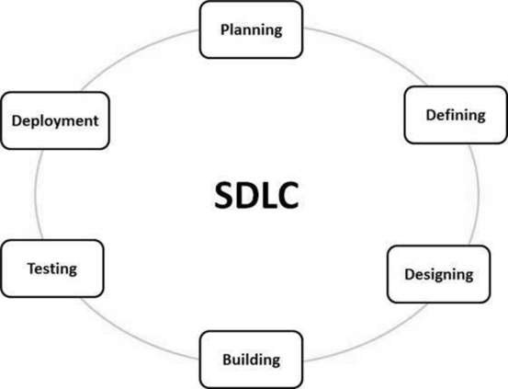
Software Development Process
Software Development Life Cycle (SDLC) is a process used by the software industry to design, develop and test high quality softwares .
various stages of a typical SDLC include.

Slide 37
Stage 1: Planning and Requirement Analysis
Stage 2: Defining Requirements
Stage 3: Designing the Product Architecture
Stage 4: Building or Developing the Product
Stage 5: Testing the Product
Stage 6: Deployment in the Market and Maintenance

Slide 38
Add to your assingment
SDLC Models
Waterfall Model
Iterative Model
Spiral Model
V-Model
Big Bang Model

Slide 39
ALGORITHM AND FLOW CHART
Algorithm
A sequence of activities to be processed for getting desired output from a given input.
A formula or set of steps for solving a particular problem.
To be an algorithm, a set of rules must be unambiguous and have a clear stopping point.
There may be more than one way to solve a problem, so there may be more than one algorithm for a problem.
Getting specified output is essential after algorithm is executed.
One will get output only if algorithm stops after finite time.
Activities in an algorithm should be clearly defined or it should be unambiguous.

Slide 40
Before writing an algorithm for a problem, one should find out
what is/are the inputs to the algorithm
what is/are expected output after running the algorithm.
While writing algorithms we will use following symbol for different operations:
‘+’ for Addition
‘-’ for Subtraction
‘*’ for Multiplication
‘/’ for Division and
‘← ’ for assignment.
For example A← X*3 means A will have a value of X*3.

Slide 41
Examples :
Problem : Convert temperature Fahrenheit to Celsius
Inputs to the algorithm:
Temperature in Fahrenheit
Expected output:
Temperature in Celsius
Algorithm:
Step1: Start
Step 2: Read Temperature in Fahrenheit F
Step 3: C ← 5/9*(F32)
Step 4: Print Temperature in Celsius: C
Step5: End
Problem: Write an algorithm to read two numbers and find their sum.
Write an algorithm to solve the problem.

Slide 42
Inputs to the algorithm:
First num1.
Second num2.
Expected output:
Sum of the two numbers.
Algorithm:
Step1: Start
Step2: Read\input the first num1.
Step3: Read\input the second num2.
Step4: Sum ← num1+num2 // calculation of sum
Step5: Print Sum
Step6: End

Slide 43
Type of Algorithms The algorithm and flowchart, classified to the three types of control structures.
They are:
Sequence
sequence of statements place one after the other
the one above or before another gets executed first.
Branching (Selection)
a binary decision based on some condition
if the condition is true, one of the two branches is explored;
if the condition is false, the other alternative is taken.
Loop (Repetition)
allows a statement or a sequence of statements to be repeatedly executed based on some loop condition.
They are:
Unbounded loops =those whose number of iterations depends on the eventuality that the termination condition is satisfied;
Bounded loops=those whose number of iterations is known before-hand.
Problem: write algorithm to find the greater number between two numbers

Slide 44
Algorithm:
Step1: Start
Step2: Read/input A and B
Step3: If A is greater than B then C← A
Step4: if B is greater than A then C ← B
Step5: Print C
Step6: End
Problem: An algorithm to print even numbers between 0 and 99
Start
I ← 0
Write I in standard output
I ← I+2
If (I <=98) then go to line 3
End
Reading assignment : Properties of algorithm

Slide 45
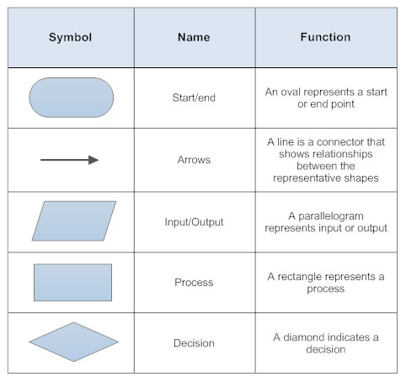
FLOWCHART
It is a diagram which visually presents the flow of data through processing systems.
It can be used for representing an algorithm.
Flowchart Symbols

Slide 46



Problem: draw flowchart to find the area of a circle of radius r.
START
READ r
Area =3.14*r*r
PRINT AREA
End

Slide 47
Problem: Flowchart for an algorithm which gets two numbers and prints sum of their value.
START
READ A , B
C = A + B
PRINT C
End

Slide 48

Problem: Algorithm for find the greater number between two numbers.
START
READ A,B
TRUE
If A > B
FALSE
PRINT A
PRINT B
End

Slide 49
Problem: Flowchart for the problem of printing even numbers between 9 and 100:
START
I = 10
WRITE I
I = I+2
I <= 98
YES
NO
End

Slide 50
Reading ASSIGNMENT = About Pseudocode

